Slide 1
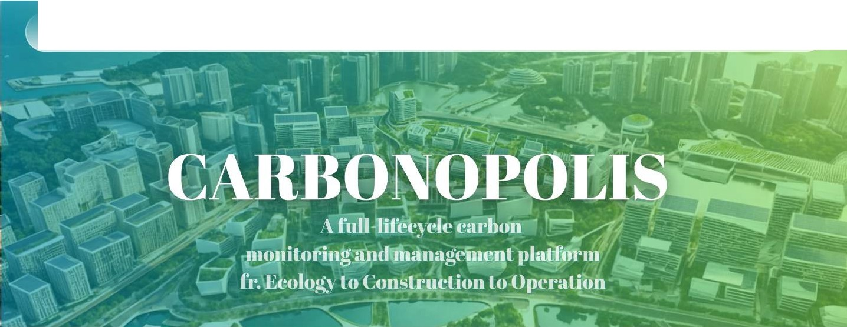




'f(CRRB□NRUTS
NJ
Phase 2 I Presentation Deck
.•.•.•
I
Carbon Neutrality Sustainability
•·······Team No.1194F •······························································ G a m e O n
I
' ...
I
......
'
' ."
••••
...
..
I
••••••
•:•: I
•
•
••
Smart, Green and Resilient
BIM + AI
f o r a N et - Z e r o N o rt her
n M et r op o I is •·······

Slide 2

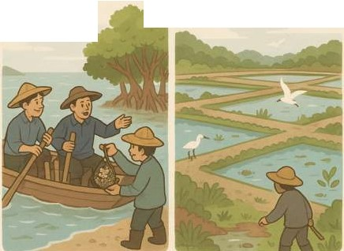


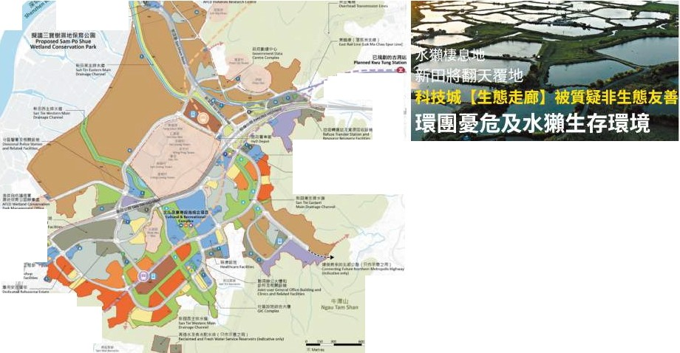
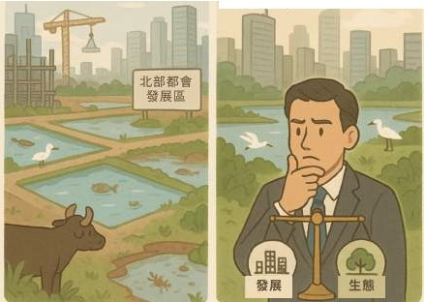

Story of SanTin
San Tin Outline Development Plan
1940 1-\:
ff
;if
ii
fciJ CarbOn Neutral@HK
f1JITMlii ill i :;I;:111111
Revised Recommended
Outline Development Plan
,,•,_¹.¹.,:,.ª,^{N}..ª_{I}...¹.¹__{I!}
b••-, ... -
,
1
a•it;aa■■
.0-tu"CN.. h
H- °'"""lo,ment Ate1
2025.q:.
"₋₋*₋..₋.._{'-}.•..₋...₋..₋.₋. _{-'-}
•₋•·•₋•
''
--­
....
, ..., ...
"""IIW_'"
Co-existence of Development and Conservation
''
-- Ms Bernadette Linn, JP Secretary for Development
"----'f
_.,,.
- ·••---
·-------, ·
_,w,_..,.._ ,-
•:llll•ftl N-1!_,
-
I
I
I
CARBONOPOLIS
•••••••••••••••••••••••••••••••••••••••••••••••••••••••••••••••••••••••••••••••••••••••••••••••••••••••••••••••••••••••••••••••••••••••••••••••••••••••••••••••••••••••••••••••••••••••
••••••••

Slide 3


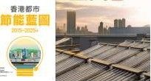







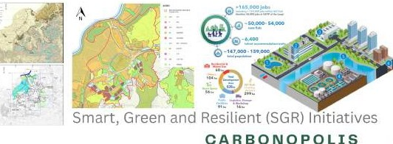
Stakeholders & Key
Challenges
!
!
l
ff' ii ii
/aJCarJ>On Nt>utral@HK
-ffi'ji
tltifil1J
EIIJS
I
I
I-
I
I
!
w
',. •, .
•
·-
I•
of the Northern Met{of?.olis
-
I
.,..
₋ 4₋.5·8
I
....
....
,.,,
Target
•
Concern:
Policy Implementation, Public Trust
◄--►""
•••
Government
I
I
6.30
2-3
CIJoffl
• • • • • • • • • • • • • • • • • • • • • • • • • • •••••••••••••• •••••••••••••••••••••••••••••••
• •••••••••••••
• •••••••••••• • ••••••••••••• • •••••••••••• • ••••••••••••••
•••••••••••••
2022
63% of carbon emissions came from power generation.
Concern:
ESG Pressure, Brand Responsibility
2023
Buildings in Hong Kong consume approximately
.--..... 90% of the electricity
Developer & Tenants
• • • • •• • •• •• • • • • • • • •• • • •• •• • • • • • • • •• • • •• •• • • • • • • • •• •
•• •• • • • • ••••••••••••• ••••••••
••••• •••••
••••••• •••••••••••••• •••••
••
Concern:
Design Trade-offs, Tool Shortage
I
Town Planners
•••••••••••••••••••••••••••••••••••••••••••••••••••••••••••••••••••••••••••••••••••••••••••••••••••••• •••••••••••••••••••••••••••••••••••••••••••••••••••••••••••••••••••••••••••••••••
• • • • • • • •

Slide 4



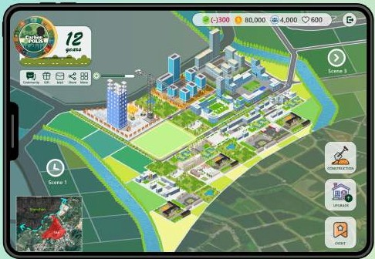
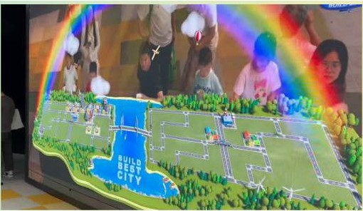



•
•
CARBONOPOLIS
A Digital Twin City-Building Game
" Have fun as a real estate tycoon making San Tin a net- zero place.
,,
1.0t
Carbon
Source: Simulated City-Building Game at the Urban Planning Exhibition Hall
Shenzhen
Our "Carbonnopoly", carbon emissions
Initiative, embodies from the
life-cycle development into tokens, "Carbon Coins"
Ecology Construction Operations
•••••••••••••••••••••••••••••••••••••••••••••••••••••••••••••••••••••••••••••••••••••••••••••••••••••••••••••••••••••••••••••••••••••••••••••••••••••••••••••••••••••••••••••••••••••••
CARBONOPOLIS
••••••••

Slide 5
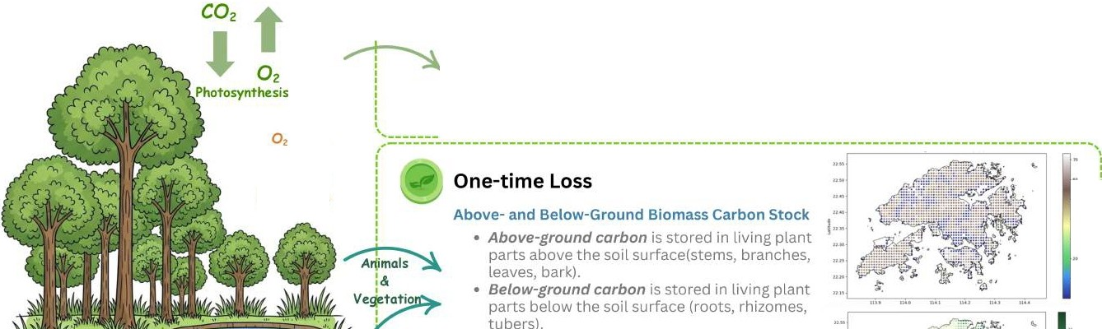
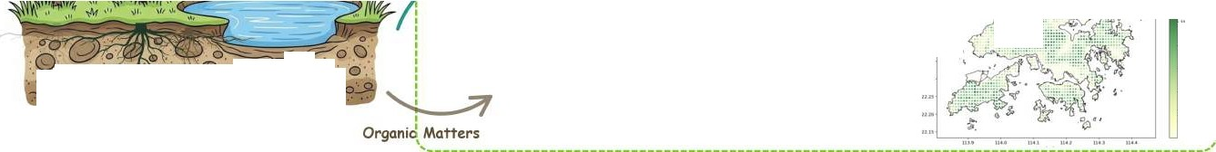
Land Acquistion: Carbon Stock in Raw Land
CARBONOPOLIS
How much of the carbon stock vanished when turning undeveloped
land into buiLt? ,
,
I!
I
^{L} ong ^{L} oss
-term
•• --- --
']
..
··
::
, , •:mm:,"'·
'
Net Ecosystem Exchange (NEE)
::: ,
,
NEE = Reco- ^{Gpp*}
NEE is the net exchange of CO2 between an ecosystem and the atmosphere. When NEE is negative, the ecosystem absorbs CO2.
*GPP: Gross Primary Productivity
lnu ,
,..
nn
·,·...·,₋.,₋.•,!.,₍.',"",,
.· ...·,
.... - .....
:ii""iic!h.'<f a..
'
l ·
djf · :/.\ di
n.!1-
- Yo
'---,-.,,--.,-, ---,--,.u--,"-,--,"-•-'
nn
•,
,
'
;
COz
Respiration
•
-
•
•
•
,,.
.......
..,.....
-
Soil Organic Carbon Stock
The total amount of carbon stored in soil organic matter within a specific depth and area.
.....•....................
I
1
. .
-
..
. .·· .
.,.,_....., . .-0. ⁰/il · Ci.
.^{un}..
O o ' .
w.0 o-·⁰ :a,.
• • •
• •
'
The following data areGauss·Kriginginterpolated

Slide 6





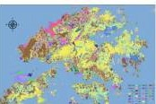
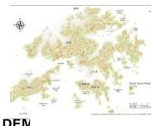
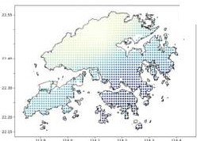
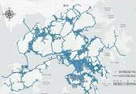
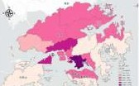
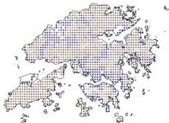
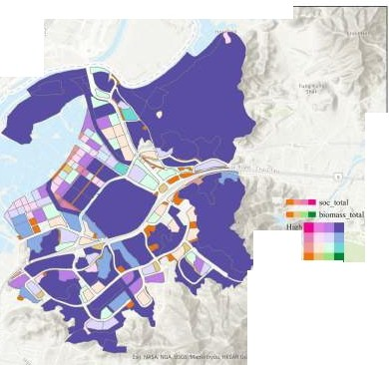
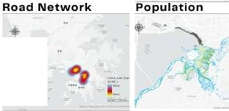
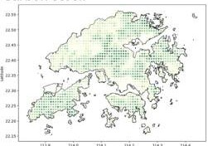
Land Acquistion: Carbon Stock in Raw Land
1111!11 It JIItt 1Jl12€:l
Common Spatial Data Infrastructure
CARBONOPOLIS
Input Features
Target Variables
..
Al
...
..,
laut
...
Training Set
GeoAI CatBoost
Prediction Model
Model R² = 87.4%
LandUtillzation
Net Ecosystem Exchange
Results: Carbon stock of San Tin by block
•
•
•
•
•
•
•
•
-
·*·
"
iiicb
••
..
<
•
...
1111 uu
110!
,,., u.o, u ..
-
Above- and Below-Ground Biomass Carbon Stock
...
•
•
•
•
Carbon ₋Au₋dit₋₋₋ Wetlands
••
-
.
l.,.
lawHigh
o 0.2 o.sk
t:-t H
-
··.·-₋-₋-₋.
• • • •
-
··₋-·-
■ ■ ■
.-··
• •
1. u
U.11,
■
■
■-■₋
■
.. ■ :- ⁻
• .•.
·-
,.. .-t "
OqIi;,,.•---·--·
...
-■...
'
-...-.
IM-<--W llf..
CECMWF
d'Rl 1SRIC
SoilOrganic Carbon Stock

Slide 7




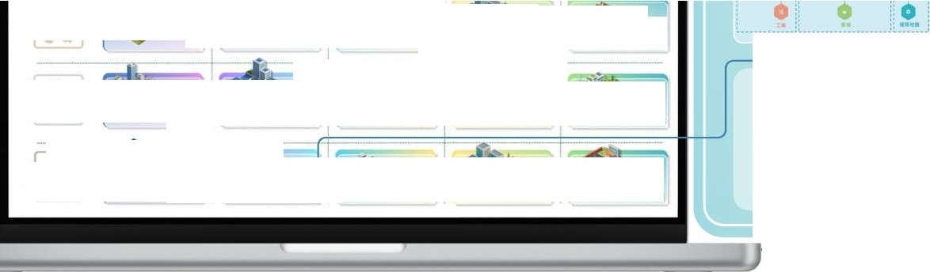
Carbon Footprint: Model Buildings Energy Consumption 1je
16
CARBONOPOLIS
Referring to BEAM Plus and other global green building standards, we used the CIC Carbon Assessment Tool to evaluate 24 building types across six functions and four low-carbon development models, calculating their carbon consumption during construction.
Aessessment Method,...
Business Block Design Parameters
Estimation of
Main MaterialUsage
PlotSiz•
(mxm)
Relnfo""d Concret•
• •OA$1}.,.'l)I b111d"4..o•••
A8,000t
30,000
fAR
Steel
QO> h)ff\'.'I'"
8,400t
Residencial Block
100'150
Business Block
150*200
Commercial Block
100•200
Public Building Block
100'100
Green Space Block
75•100
Buildlnc Hcla,ht Umlt tm)
75
8ulldlna
Are.a(m2t
120,000
Baseline
Earthwort E)ic;1vatlon
votume
Plot SizeIm• ml
BuUding H•lrht
Umitlm
Building Arn(m')
Green space
ftatjo
Average
20% Number of
Floors
Development i..
G SU-sage
3601:g
10
·101.oirot me,,,..,1-.u"'"
150
75
25
40k
15
10
I
-
60kg
----- Paint/Coatin.E!
••
-
'"l'P'"""'"t 1d"!ltal"'
180k
120k
10k
2.Sk
qtl;o, ... ---
.,.,.,
OJ.JOO
Bl
CIC Carbon Assessment Tool ISO
jifll'/l J.1-_{lF}:_{I} CJ\
----1
/-=
.,....
··
...
...
......
GI
ts-O-l,tq&A
erp,- ar119.r
•
·
Result
Dirno sttat1jn
G UOO
I I
i
.. uoo
Pl
.U,c,f!UICQ,,,o
ll 1
-
--
mi ions
......_0-1,o
-
-,..
,,.
000
t.soo
)1'.1.1,M .01'Ul(:Q,o
....
....
...
JUOO
.•..
..,..l''ilia;i,,.
Advanced Low-Carbon Development
......
..,
.....
C.:l
,a l.SOO
11:l
113
.,....
b(A1-A3) ■•<Ml
Total Carbo
l :1
fl(AS)
42127.83 (tCO,e)# 42k
-··-•-"·
Basic Low- Carbon Development
-·-·
-
-
-·
i
-
LifeCycle CarbonEmissions CLCA)
.".".
=. 2,500
r;!
,.,.
..¹.⁰⁰.⁰ ...
...,¹⁵..⁰..
l"l
"'
Geopolymer concrete Green Roof Materials
112 I
100
Sol,1 Photo11olta ic ntegrat 101"1 n t
' 500
uoo
Reclaimed Wooc\iyn•m1c Gt.zing Technology
·-
.-.-·--=--·-·w1'l ·
112
r·,
Heat Pumps
I ,
a10-Based lnsuldon
(
---·-·-·..
..
'naMouJ. !""site M u fcYSr-tn½qgSM)
-·
...
0
..,⁷⁰..⁰ ..
111
,,,..,..........
C:I
. ....
Prefabrication
T e Baselin,t,
(> ""' .., -.a.: IOO
.l
......
l'I
,.
DivefopmenJ'
£! .......
Ill
f\<tcJ?ifit.i.r PtLl t clJy .t ion
Building Carbon Reduction Technologies
I
c;I
••••••••••••••••••••••••••••••••••••••••••••••••••••••••••••••••••••••••••••••

Slide 8
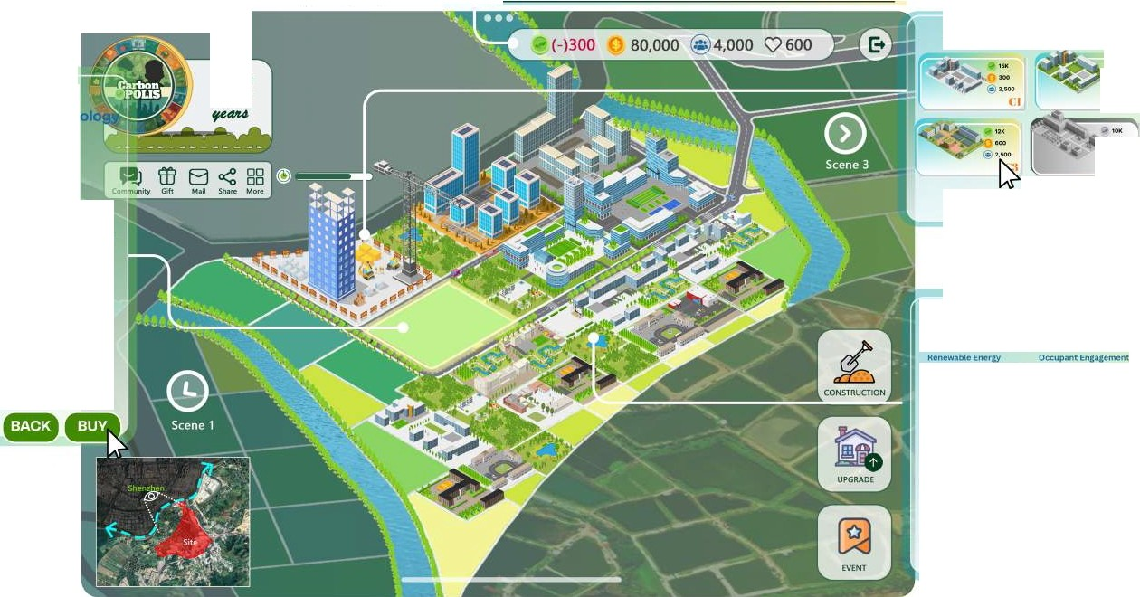
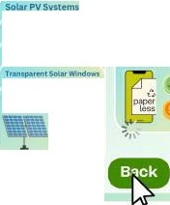
Game Design I Everybody embraces the low-carbon SanTin
CARBONOPOLlS
In this city-builder game, you will play the role of an eco-responsible developer who can purchase a block of land, build buildings, and also involve in the operation of your properties. Your P-erformance is marked in several dimensions.
Step 2 -
Construction
Step 1 -
Purchase Land
SELECT YOUR BUILDINGS
12
""' .".'.
LAND ATTRIBUTE
Land use.Innovation & Techn
eiuoo
,:z
Floor Area Ratio: 3.0
Building Height Resttictions. 75 m
,..
One-timeCarbon Stock Loss: 22
Back
Select
Long-ter111Carbon Stock Loss:
5 ear
Step 3 -
Operation
Key Ecological Resources:
Loss of pond and other w t and
e
J
habitats
Key Impacts:
Direct loss of pond habitat hat is utilised by high diversity and abundance of avifauna
LAUNCH A CAMPAIGN TO NUDGE
Weiland ReJtOr:ltlOn
111ueate.SU1tt on Emra:,
S11'1in1
Solar Wator Heaters
Promote cyoUng
81odlu:clsy,tc"1$
wastesegreg don
Paperless Offices
Photovo1tafes
+1360
+ 2t!lO
Select

Slide 9

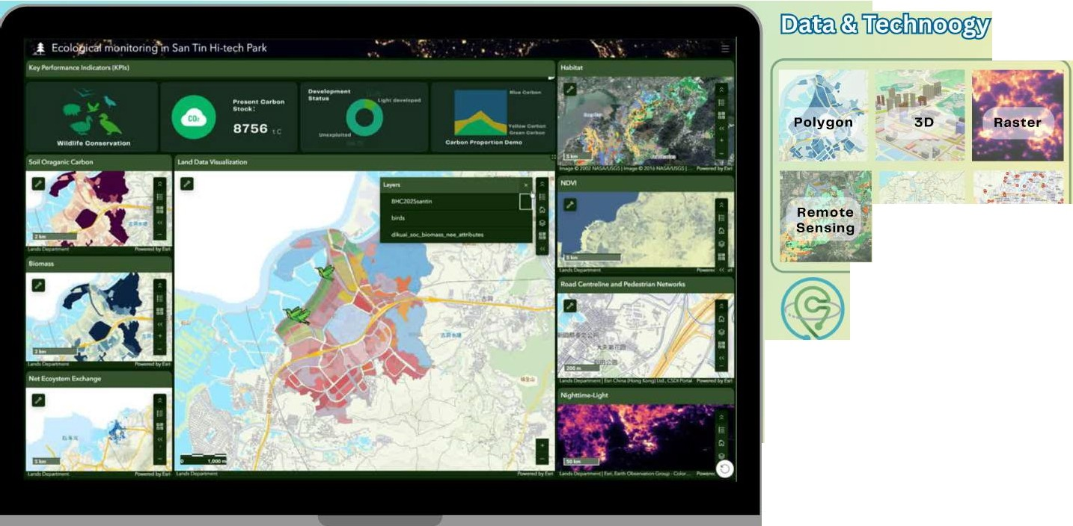

CARBONOPOLIS
Polyline
,.;."'
Point .=
ffll-•
sp:g
Common Spatial
Data Infrastructure
scientific data
Google Earth Engine
CECMWFl50
HKMS2D
•••••••••••••••••••••••••••••••• CARBONOPOLIS •••.....

Slide 10
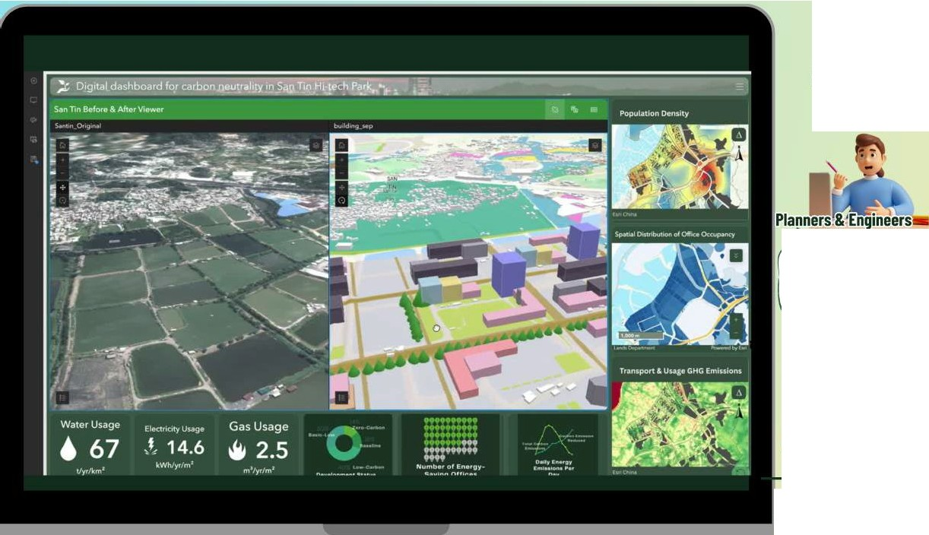




CARBONOPOLIS
It will help me find more cost-effective waysto go greener and boost profits.
Developers & Tenants
Support low carbon management; Monitor resource consumption across the entire
portfolio.
s
Thesystem promotes transparency and credibility of green buildings for sustainable cities.
This provides refined carbon management and helps track policy outcomes effectively.
r
For Al-Based Evaluation and Carbon Neutral Plan Report in San Tin Hi-tech District
CARBONOPOLIS •••.....
CO2
••••••••••••••••••••••••••••••••

Slide 11

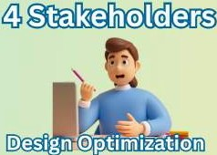
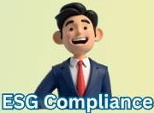


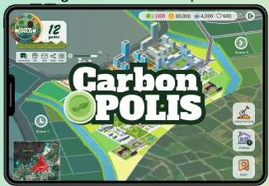
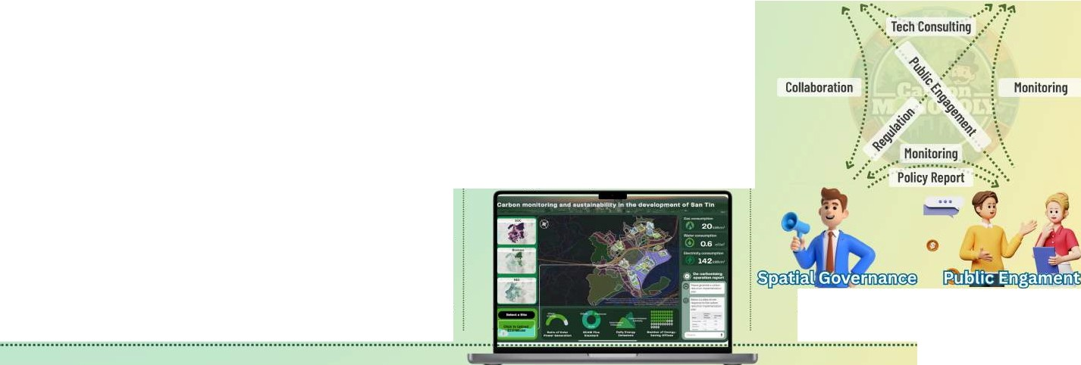


CARBONOPOLIS
City-Building Game
" Have fun as a real estate tycoon making San Tina net-zero place.
1.0t
Carbon
,,
Town Planners
Developer & Tenants
Our Initiative, "CARBONOPOLIS", embodies carbon emissions from the life-cycle development into tokens,
........"Carbon Coins"'
......................................................................................................................................................................................
Smart Dashboard
" See the sandbox, carbon stock, and enegy consumption in one screen.
Ecology
How much carbon is additionally produced if we turn araw land into a built area?
,,
Construction
To what extent does it work to utilise more eco­ friendly materials and construction tech?
Operations
What can we do to reduce carbon just as ordinary people or new tenants in the San Tin?
Government
Public
CARBONOPOLIS
•••.....

Slide 12

CRRB□NRUTS
References
•
•
Hammond, G., & Jones, C. (2008). Inventory of carboQ,/!8c
•
•
•
•
•
•
De artment of Mechanical Engineering, University of.Batn.
•
•
••
•
•
Wong,
J.
K
. W.,
&
Kuan,
•
•
•
• •
Construction, 44, 163-17.5.
•••••••••••••••••••••••••••••••••••••••••••••••••••••••••••••••••••••••••••••••••••••••••••••••• Game On for
a Net-Zero Northern Metropolis
••••••••

